Slide 1

CSP554 Project Phase1 Team 8
Sihan Yang
Yawei Zhu
Chengen Lee

Slide 2
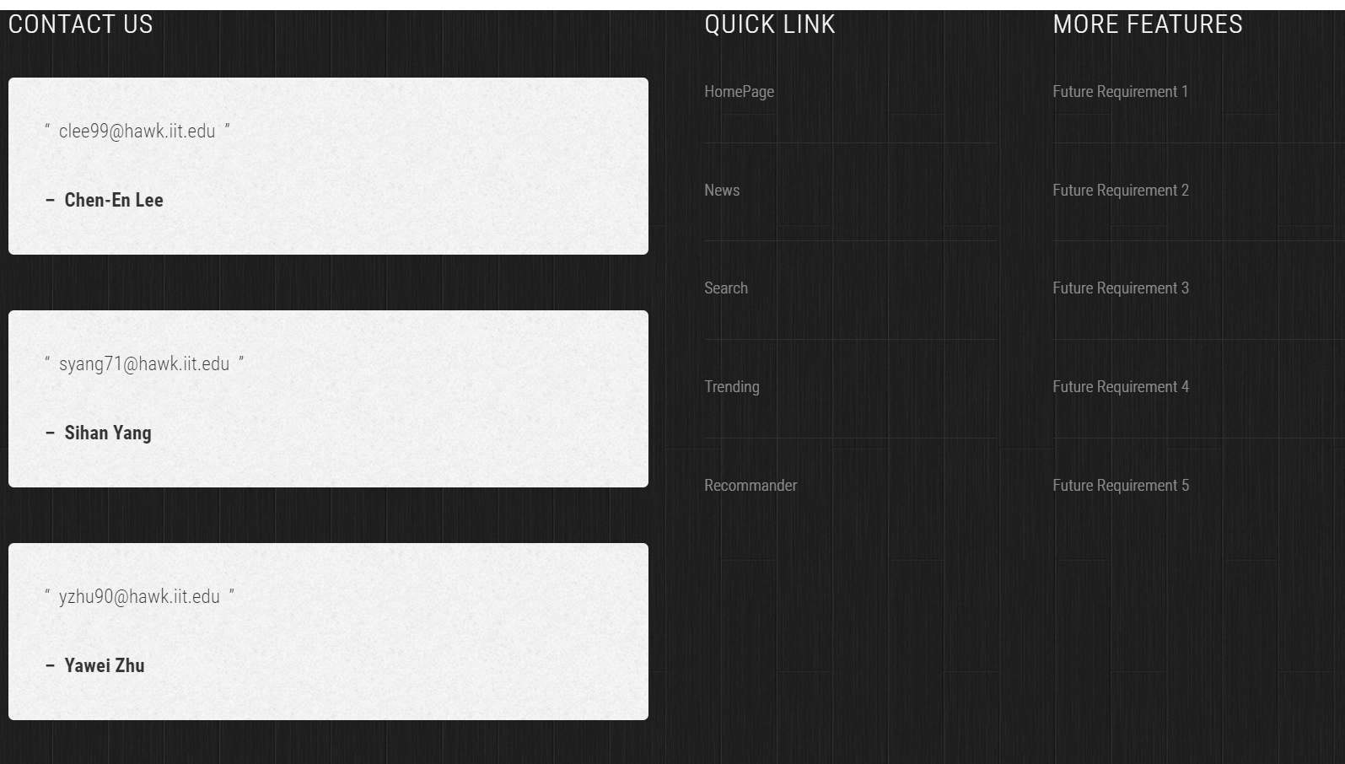
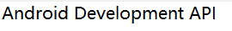
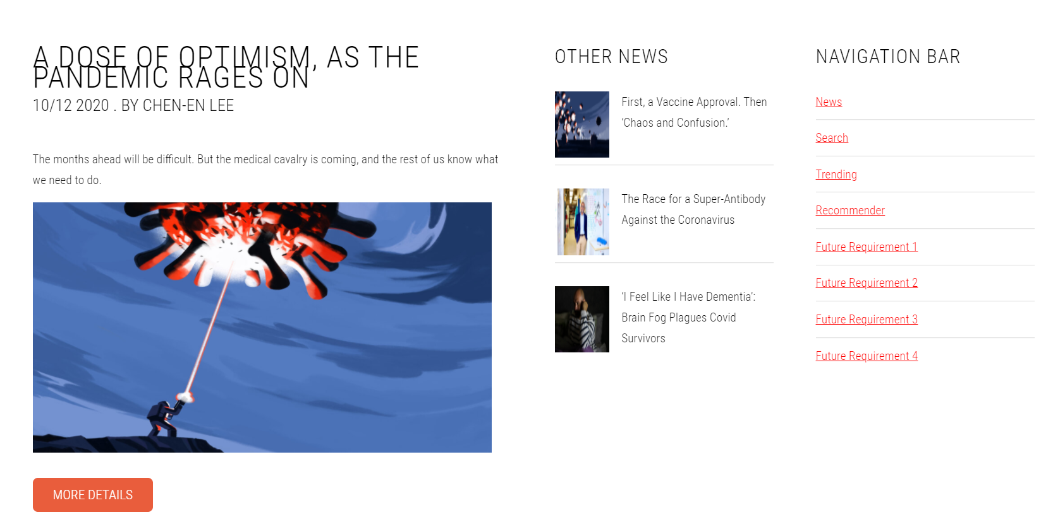

Home page:

Slide 3
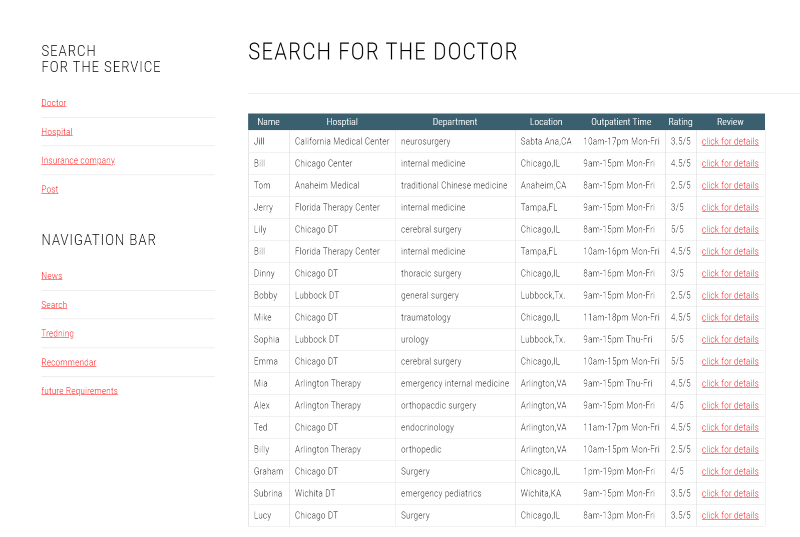
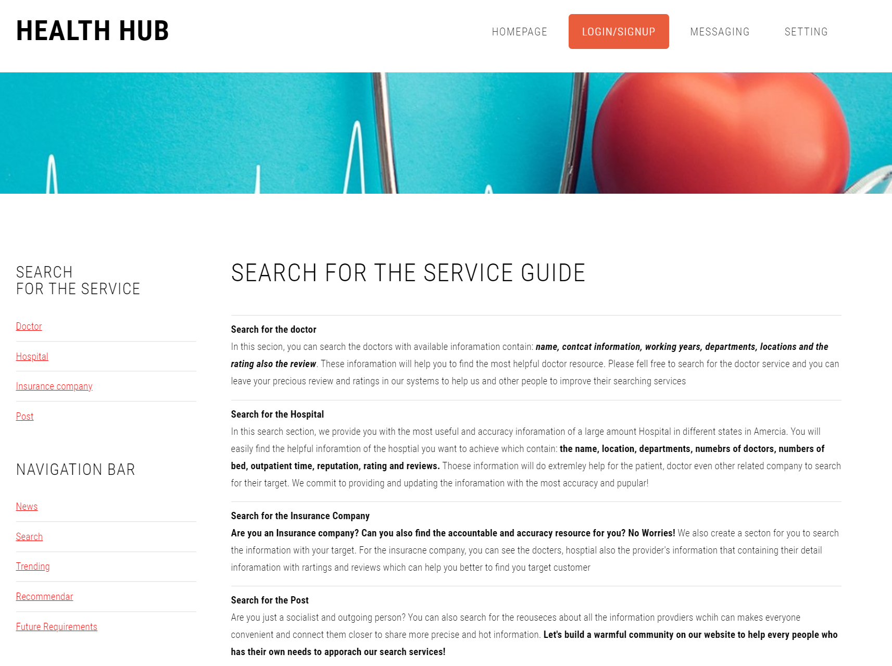
Search Function
MySQL
MongoDB
Graph databse

Slide 4
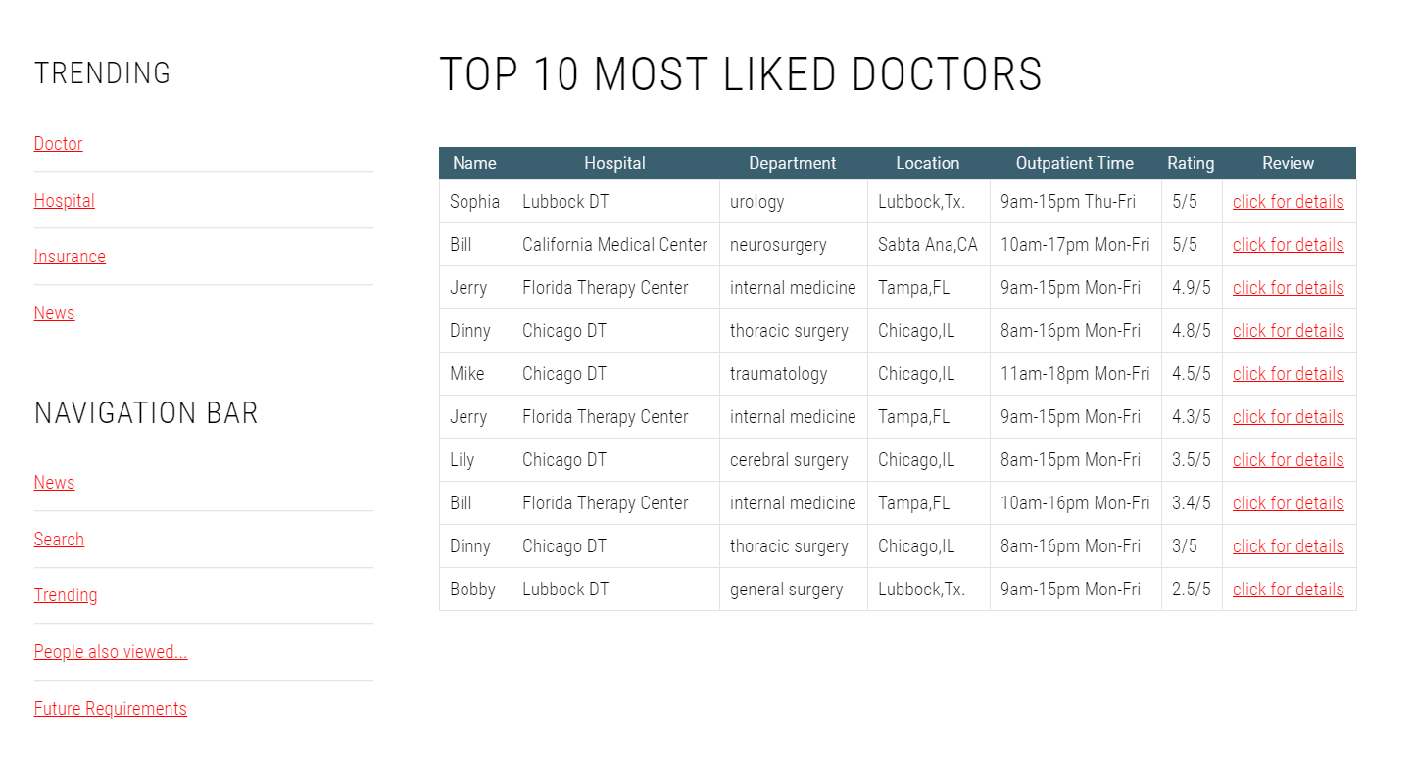
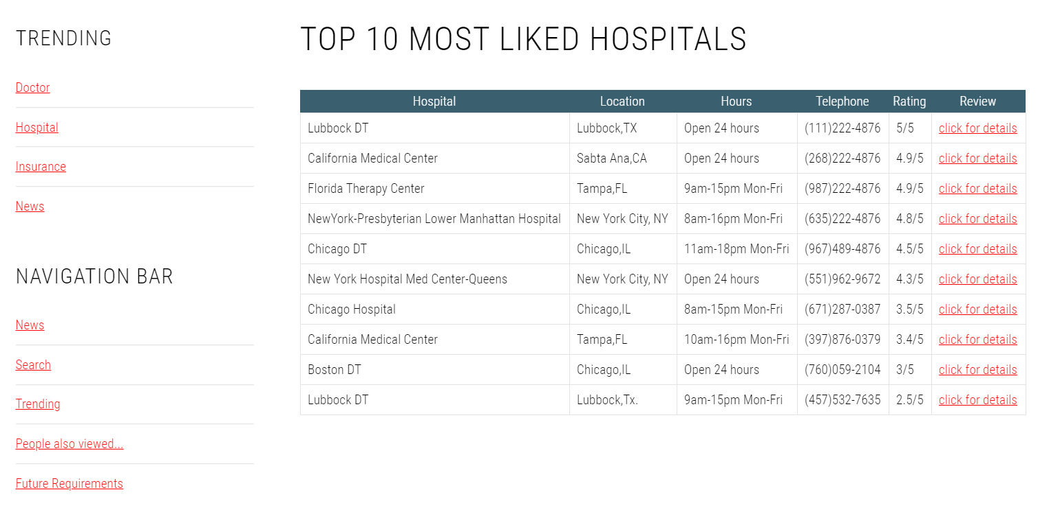
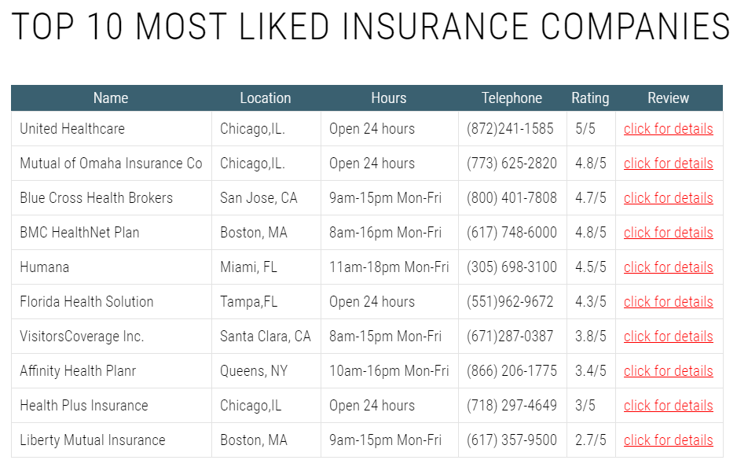
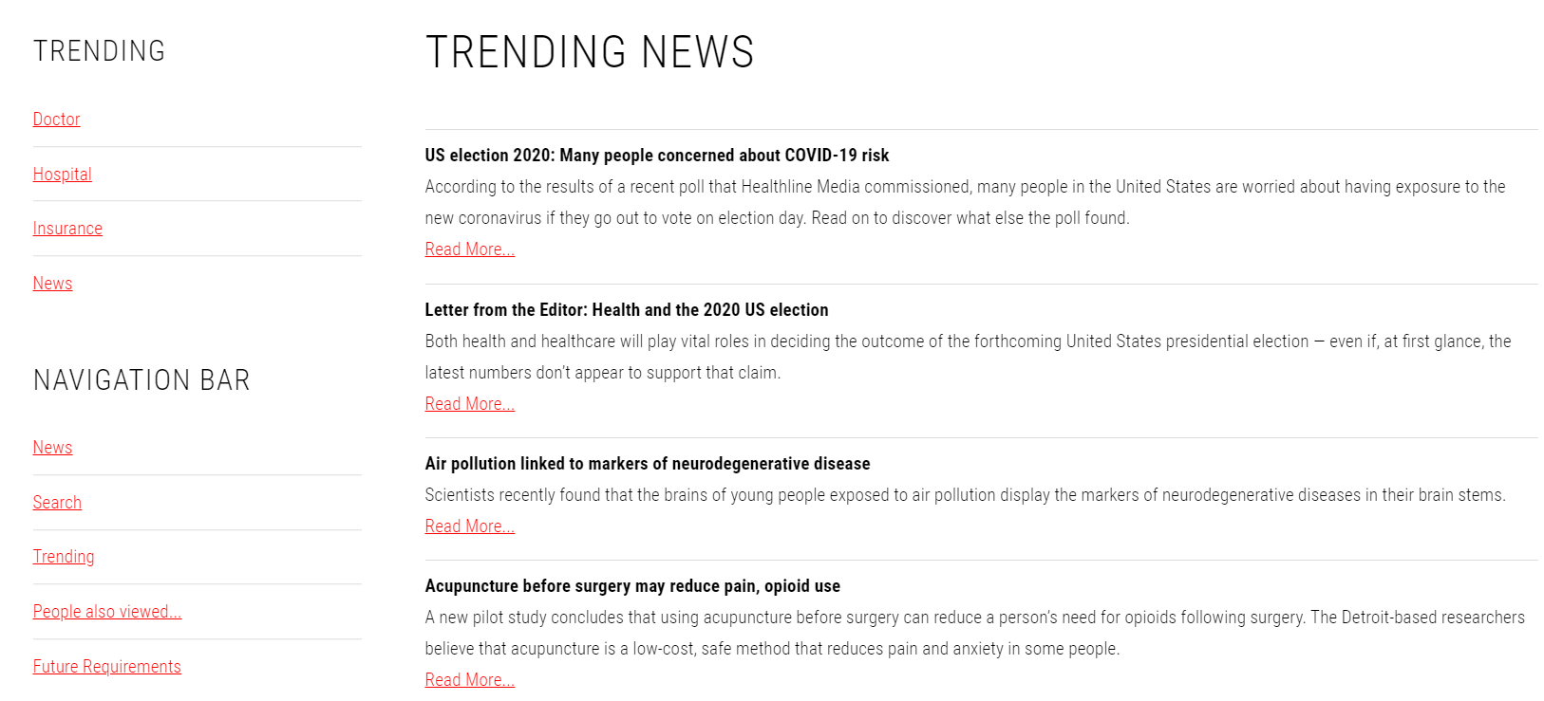
Trending Function
MySQL
MongoDB
Graph databse

Slide 5

Recommendation Function
Tools:
JSP
Android API
Database tools:
MySQL
MongoDB
Graph database

Slide 6
Thanks for watching!
Questions?

